Slide 2
THE DISCIPLES RELATIONSHIP:
TO HIMSELF
An Athlete
A Soldier
TO HIS LORD
The Potter and the Clay
The Vine and the Branches
A Child of God
TO HIS BRETHREN
A Member of the Body
“My Brother’s Keeper”
A Servant
TO THE WORLD
Strangers & Pilgrims
Salt & Light
An Apologist
Fishers of Men

Slide 3
LESSON 4: The Potter and the Clay The Disciple’s Transformation
As this potter am I not able to do to you? O house of Israel, an affirmation of Jehovah. Lo, as clay in the hand of the potter, So are ye in My hand, O house of Israel. (Jeremiah 18:6)

Slide 4
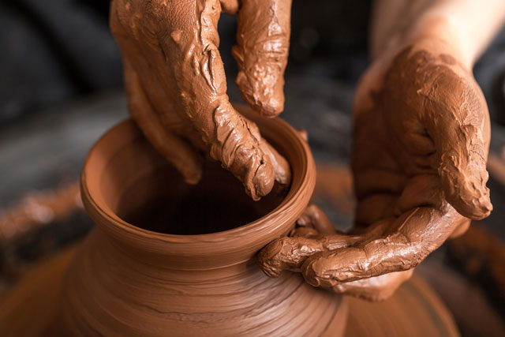
The Disciples Transformation
God is the Potter
Disciples are the Clay
We are molded by the Lord’s Teaching
This molding is a Process
The Molding has a Purpose

Slide 5
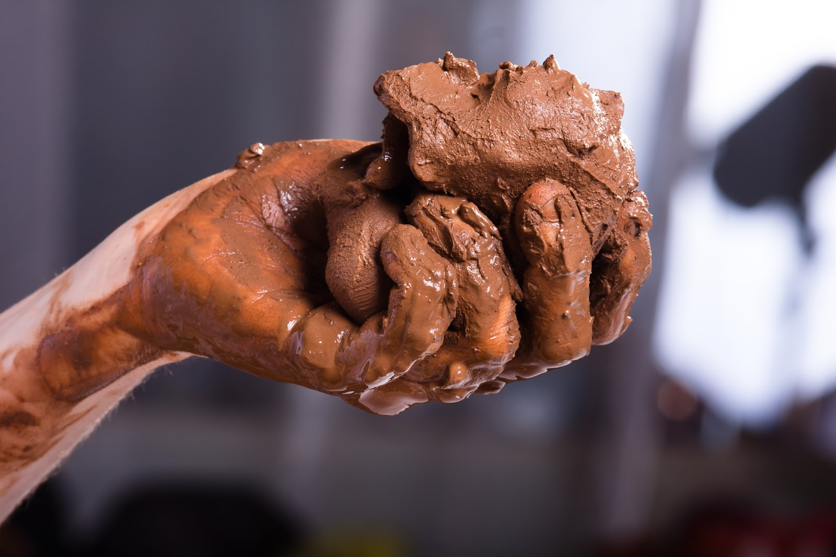
The Disciples Transformation
God is the Potter
Disciples are the Clay
Jeremiah 18:1-11
What do we learn about God from this passage?
How much control did the clay have?
None
How much control did the Potter have?
Absolute

Slide 6
The Disciples Transformation
God is the Potter
Disciples are the Clay
Jeremiah 18:1-11
How much control did Israel have?
They could obey or not
How much control did God have?
Absolute
When God relents, that is called what?
Mercy

Slide 7
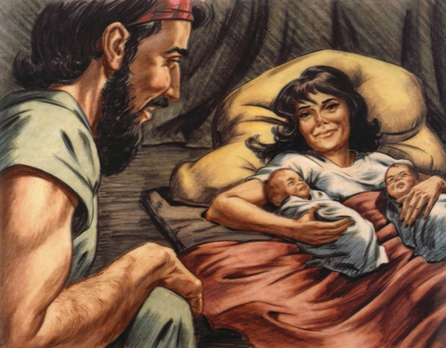
The Disciples Transformation
God is the Potter
Disciples are the Clay
Rom 9:9-24
Does it say God determine either man’s eternal destiny?
Could God have punished Pharaoh sooner?
If Pharaoh would have changed, would God have punished him?

Slide 8
The Disciples Transformation
God is the Potter
Disciples are the Clay
Rom 9:9-24
Us as clay, how much control do we have?
Obedience
God as the Potter, how much control does he have?
Absolute
And His patience? Mercy

Slide 9
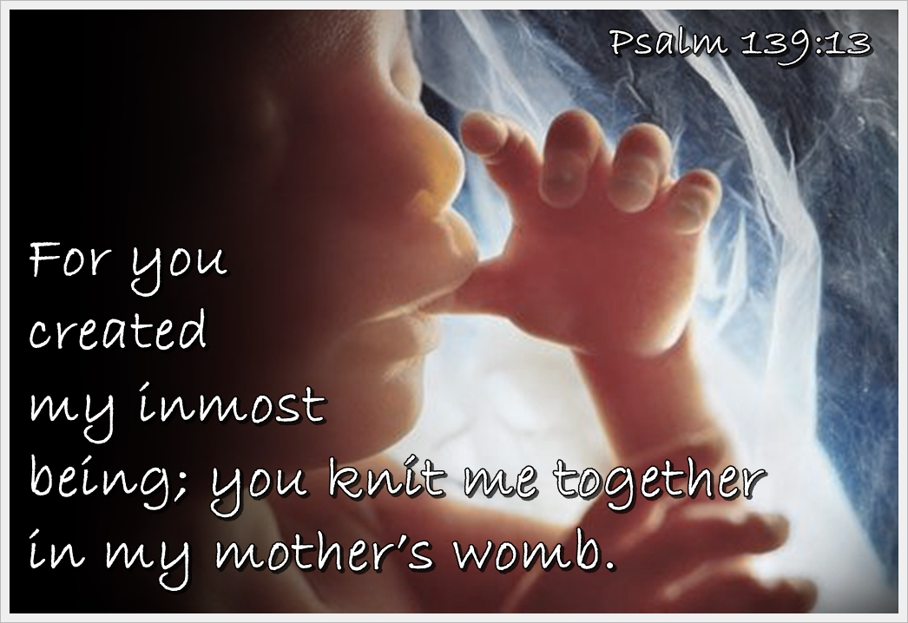
The Disciples Transformation
God is the Potter
Disciples are the Clay
Ps 139:1-6 God knows you
Luke 12:4-7 God loves you
Duet 6:23-24 God knows what is best
Ps 139:13-16
Ordained - to mold into form as a potter
- to form a resolution

Slide 10
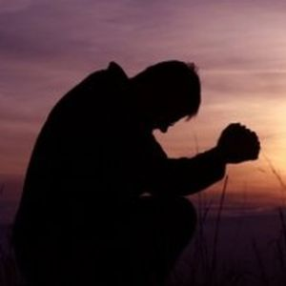
The Disciples Transformation
God is the Potter
Disciples are the Clay
(James 4:7-10) Submit therefore to God. Resist the devil and he will flee from you. Draw near to God and He will draw near to you. Cleanse your hands, you sinners; and purify your hearts, you double-minded. Be miserable and mourn and weep; let your laughter be turned into mourning and your joy to gloom. Humble yourselves in the presence of the Lord, and He will exalt you.

Slide 11
The Disciples Transformation
God is the Potter
Disciples are the Clay
(1 Peter 5:5-7) You younger men, likewise, be subject to your elders; and all of you, clothe yourselves with humility toward one another, for GOD IS OPPOSED TO THE PROUD, BUT GIVES GRACE TO THE HUMBLE. Therefore humble yourselves under the mighty hand of God, that He may exalt you at the proper time, casting all your anxiety on Him, because He cares for you.

Slide 12
The Disciples Transformation
God is the Potter
Disciples are the Clay
(Philippians 2:8) Being found in appearance as a man, He humbled Himself by becoming obedient to the point of death, even death on a cross.
What does it take to say: “Okay Father whatever you want to do.”
Faith, Trust

Slide 13
The Disciples Transformation
God is the Potter
Disciples are the Clay
(James 1:21) Therefore, putting aside all filthiness and all that remains of wickedness, in humility receive the word implanted, which is able to save your souls.

Slide 14
The Disciples Transformation
God is the Potter
Disciples are the Clay
What power is within us, to affect our life?
Obedience
How much power is in God’s hands?
Absolute
When we are obedient, God is what?
Merciful

Slide 15
The Disciples Transformation
Go be clay in God’s hands

